Slide 1
Leadership & Change
in The Local Church
Southwest Indiana
District
Presenter: Steve Greene
Lead Pastor, The Point

Slide 3
Psalm 32:8 (NIV)
^{[8]} I will instruct you and teach you in the way you should go; I will counsel you and watch over you.

Slide 4
Are we willing to
CHANGE our METHODS
to more effectively accomplish our MISSION?

Slide 5
“Change is inevitable. Growth is optional.”
- John Maxwell

Slide 6
We must begin by
being willing to
ADMIT THE NEED
for change.

Slide 7
WHY DO PEOPLE
RESIST CHANGE?

Slide 8
On a scale of 1-10,
how well does your
church adapt to change?

Slide 9
WARNING: If we fail to recognize
the changes in the world around us, we’ll miss out on the opportunity to share the gospel.
Not because the Gospel is irrelevant…
But because we are.

Slide 10
The Danger of Denial…

Slide 11
The Danger of Denial…
Irrelevance

Slide 12
The Danger of Denial…
Irrelevance
2. Lostness

Slide 13
The Danger of Denial…
Irrelevance
2. Lostness
3. Lost Opportunities

Slide 14
The Danger of Denial…
Irrelevance
2. Lostness
3. Lost Opportunities
4. Disobedience.

Slide 15
The Danger of Denial…
Irrelevance
2. Lostness
3. Lost Opportunities
4. Disobedience.
5. Comfort becomes an idol.

Slide 16
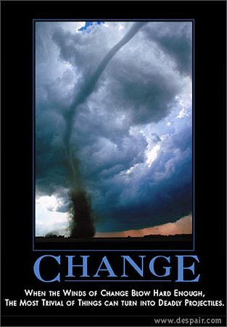

Slide 17
Tips for Initiating Change:

Slide 18
Tips for Initiating Change:
Begin on your knees

Slide 19
James 1:5 (NIV)
^{[5]} If any of you lacks wisdom, he should ask God, who gives generously to all without finding fault, and it will be given to him.

Slide 20
Tips for Initiating Change:
Begin on your knees
2. Expect Opposition

Slide 21
Tips for Initiating Change:
Begin on Your Knees
Expect Opposition
3. Love the People

Slide 22
Nehemiah 6:3 (NIV)
^{[3]} "I am carrying on a great project and cannot go down. Why should the work stop while I leave it and go down to you?"

Slide 23
Tips for Initiating Change:
Begin on Your Knees
Expect Opposition
Love the People
4. Exercise Wisdom

Slide 24
Tips for Initiating Change:
Begin on Your Knees
Expect Opposition
Love the People
Exercise Wisdom
5. Stay Focused

Slide 25
Hebrews 12:2 (MSG)
^{[2]} Keep your eyes on Jesus, who both began and finished this race we're in. Study how he did it. Because he never lost sight of where he was headed -

Slide 26
that exhilarating finish in and with God - he could put up with anything along the way: cross, shame, whatever. And now he's there, in the place of honor,
right alongside God.

Slide 27
Tips for Initiating Change:
Begin on Your Knees
Expect Opposition
Love the People
Exercise Wisdom
Stay Focused
6. Evaluate Changes

Slide 29
Q & A

Slide 30
Website www.gotothepoint.com
Email steve@gotothepoint.com
Cell 812-216-3128
Facebook
www.facebook.com/thepointIN
www.facebook.com/steve.greene.737

Slide 31
Leadership & Change
in The Local Church
Southwest Indiana District
Presenter: Steve Greene
Lead Pastor, The Point

