Slide 1
CREATING AN ANNUAL MINISTRY ACTION PLAN

Slide 3
Leaders don’t feel ENTITLED they feel RESPONSIBLE.

Slide 4
Leadership is a stewardship, it’s temporary, and you’re responsible.
- Andy Stanley

Slide 5
It’s not our church, it’s Jesus’ church.

Slide 6
Every Pastor is an Interim Pastor.

Slide 7
Our goal is to steward the church in such a way that it sustains far beyond our stewardship.

Slide 8
Now when David had served God's purpose in his own generation, he fell asleep; he was buried with his ancestors and his body decayed.
- ACTS 13:36

Slide 9
"A leader is best when people barely know they exists, when their work is done, their aim fulfilled, they will say: we did it ourselves."
- Lao Tzu

Slide 10
TWO MODELS FOR CREATING
AN ANNUAL MINISTRY ACTION PLAN

Slide 11
1. THE MOSES MODEL

Slide 12
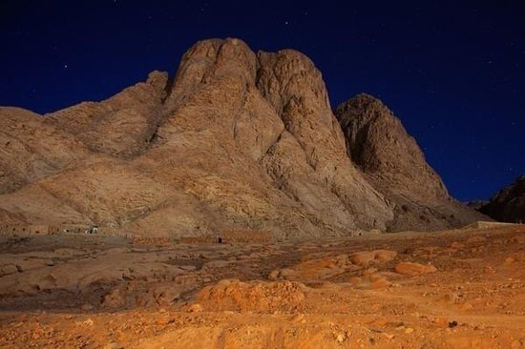

Slide 13
2. THE NEW TESTAMENT MODEL

Slide 14
So Christ himself gave the apostles, the prophets, the evangelists, the pastors and teachers, to equip his people for works of service, so that the body of Christ may be built up until we all reach unity…
EPHESIANS 4:11-12

Slide 15
Unity is the result of a team-based approach to leadership.

Slide 16
Every year, the pastor and the church board shall conduct a planning session to renew the expectations and goals of the church and the pastor. The written understanding of goals, plans, and objectives between the church and the pastor shall be updated. Such written understanding shall be filed with the district superintendent.
MANUAL PARAGRAPH 122

Slide 17
“Lifeway Research has discovered that the number one cause of Sr. Pastor transitions is misalignment between the Sr. Pastor and the Church Board/Congregation.”
- Thom Rainer

Slide 18
“Nothing will impact the health and growth of your church as much as the unity and alignment of your Senior Leadership Team.”
- Larry Osborne

Slide 19
BEST PRACTICES
FOR CREATING
AN ANNUAL
MINISTRY ACTION PLAN

Slide 20
Set the date for a leadership retreat 6 months in advance of the new church year.

Slide 21
Hold it off-site if you can.

Slide 22
Prepare documents well in advance.

Slide 23
Group people in smaller groups if group is larger than 10 people.

Slide 24
Provide time for meals, prayer, relational connection, defining reality, dreaming, and deciding.

Slide 33
Create a simple Ministry Action Plan that includes:
A clear Vision Frame (mission, values, strategy, and measures)
A clear list of goals and sub-goals from your Retreat
A simple calendar
A simple budget

Slide 34
Alan Bradley 407-492-9781
abradley@nnu.edu

